Slide 1
MetaCentrum hands-on seminar
Tomáš Rebok, Martin Kuba
MetaCentrum, CESNET z.s.p.o.
CERIT-SC, Masaryk University
(rebok@ics.muni.cz, makub@ics.muni.cz)
Brno, 11. 4. 2012
Notes:
něco obecneji o gridu (nezacinat hned cesnetem), nasledne predstavit koordinatora a navazat role, projit Meta a navazat CERITem…

Slide 2
Overview
Brief MetaCentrum introduction
Grid infrastructure overview
How to … specify requested resources
How to … run an interactive job
How to … use application modules
How to … run a batch job
How to … determine a job state
How to … run a parallel/distributed computation
Brief CERIT-SC Centre introduction
CERIT-SC specifics

Slide 3
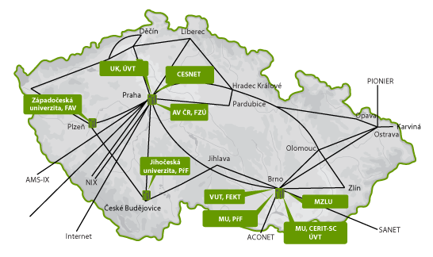
MetaCentrum @ CESNET
CESNET department
since 1996, responsible for coordinating and managing grid activities in the Czech Republic on behalf of the Czech NGI
comprises of clusters, powerful servers and storages provided by CESNET itself as well as cooperating institutions/universities
→ an environment for collaboration in the area of computations and data processing/management
interconnected with European Grid Infrastructure (EGI)

Slide 4
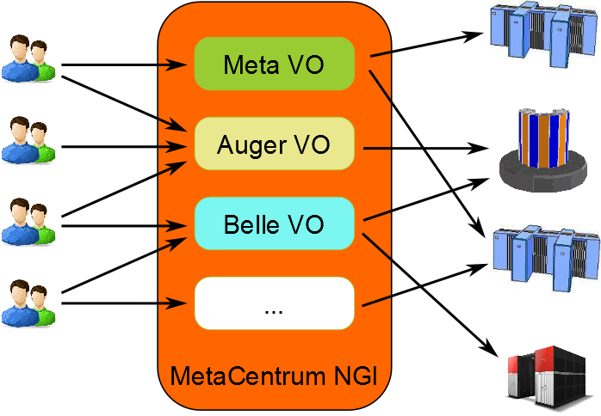
MetaCentrum NGI
NGI coordinator
users are grouped into virtual organizations (VOs)
a group of users having “something in common”
e.g., cooperating on the same project
may have specific HW resources assigned, specific policies set, specific technologies in use, etc.
MetaCentrum NGI may help with:
establishment of a new HW centre
establishment of a new VO
integrating existing resources into grid infrastructure
joining a project with european infrastructures
http://www.metacentrum.cz

Slide 5
MetaCentrum VO (Meta VO)
intended for students/employees of Czech universities, Academy of Sciences, various research institutes, etc.
offers:
computing resources
storage capacities
application programs
a part of CESNET’s e-infrastructure
data storage/repository, collaborative environment, …
free of charge (after registration)
„payment“ in the form of publications with acknowledgement
→ user priorities when the resources become fully utilized
http://metavo.metacentrum.cz

Slide 6
Meta VO – hardware
resources of CESNET + involved organizations/institutions
ZČU, UK, MU, CERIT-SC, FZÚ AV ČR, MZLU, …
→ necessary to coordinate resources of various owners (CESNET)
computing resources: 4000 cores, ca. half of them provided by CESNET
common HD nodes (2x4-8 cores) as well as SMP nodes (32-80 cores)
memory up to 512 GB per node
Infiniband for low-latency communication (MPI apps)
300 TB for semi-permanent data
storage sites in Brno and Pilsen, accessible from all clusters
prospectively being connected to CESNET’s PB storage
availability of specialized equipment
e.g. NVIDIA CUDA cards in Pilsen, 35TB scratch for temporary data (Brno)

Slide 7
Meta VO – software
similarly to HW, obtained in cooperation with involved organizations
development tools
GNU, Intel, PGI, debuggers and profiling tools (TotalView, Allinea)
mathematical software
Matlab, Maple, gridMathematica
commercial/free software for chemistry
Gaussian 09, Amber, Gamess, …
material simmulations
Wien2k, Fluent (ZČU only)
structural biology, bioinformatics
a set of freely available modules
see http://meta.cesnet.cz/wiki/Kategorie:Aplikace
we’re looking for new software proposals (free/commercial)
possibility to buy/co-finance

Slide 8
Meta VO – computing environment
batch jobs
descriptive job script
information about job’s start/termination
interactive jobs
text vs. graphical mode
cloud environment
pilot installation with CERIT-SC
basic compatibility with Amazon EC2
users do not run jobs, but the whole virtual machines
possibility to tune the image (Windows, Linux) and start it on MetaVO nodes
suitable for applications, which do not comply with the grid approach

Slide 9
Overview
Brief MetaCentrum introduction
Grid infrastructure overview
How to … specify requested resources
How to … run an interactive job
How to … use application modules
How to … run a batch job
How to … determine a job state
How to … run a parallel/distributed computation
Brief CERIT-SC Centre introduction
CERIT-SC specifics

Slide 10
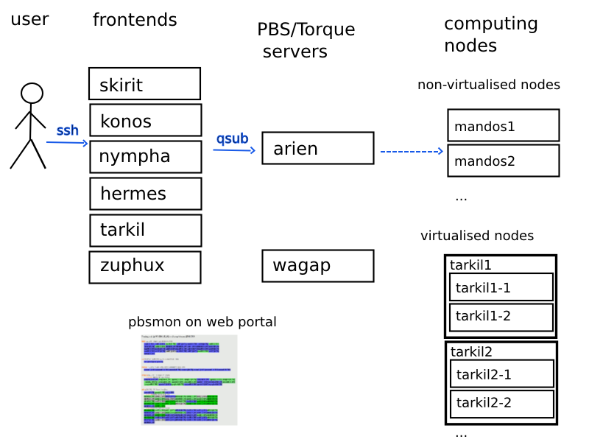
Grid infrastructure overview

Slide 11
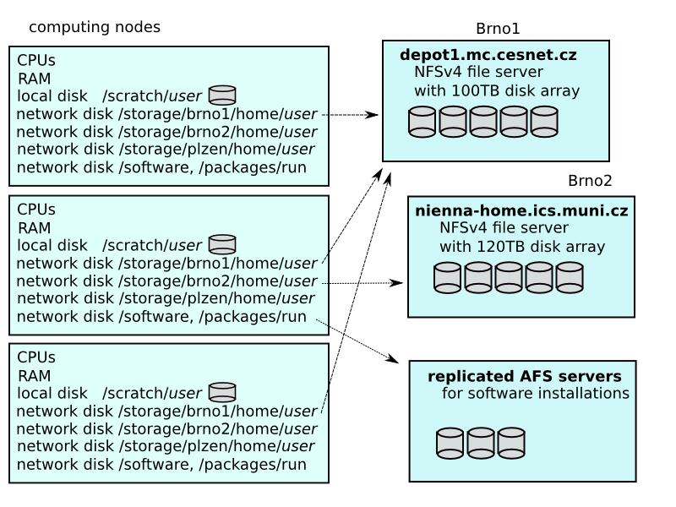
Grid infrastructure overview

Slide 12
Overview
Brief MetaCentrum introduction
Grid infrastructure overview
How to … specify requested resources
How to … run an interactive job
How to … use application modules
How to … run a batch job
How to … determine a job state
How to … run a parallel/distributed computation
Brief CERIT-SC Centre introduction
CERIT-SC specifics

Slide 13
How to … specify requested resources I.
before running a job, one needs to have an idea what resources the job requires
and how many/much of them
means for example:
number of nodes
number of cores per node
an upper estimation of job’s runtime
amount of free memory
number of software licenses
etc.
the resource requirements are then provided to the qsub utility (when submitting a job)
details about resources’ specification: http://meta.cesnet.cz/wiki/Plánovací_systém_-_detailní_popis#Specifikace_požadavků_na_výpočetní_zdroje

Slide 14
How to … specify requested resources II.
Graphical way:
qsub assembler: http://metavo.metacentrum.cz/cs/state/personal
allows to:
graphically specify the requested resources
check, whether such resources are available
generate command line options for qsub
check the usage of MetaVO resources
Textual way:
more powerful and (once being experienced user) more convenient
see the following slides/examples →

Slide 15
How to … specify requested resources III.
Node(s) specification:
general format: -l nodes=...
Examples:
2 nodes:
-l nodes=2
5 nodes:
-l nodes=5
should be used together with processors per node (PPN) specification

Slide 16
How to … specify requested resources IV.
Processors per node (PPN) specification:
general format: -l nodes=...:ppn=...
2 nodes, both of them having 3 processors:
-l nodes=2:ppn=3
5 nodes, each of them with 2 processors:
-l nodes=5:ppn=2
More complex specifications are also supported:
3 nodes: one of them with just a single processor, the other two with four processors per node:
-l nodes=1:ppn=1+2:ppn=4
4 nodes: one with a single processor, one with two processors, and two with four processors:
-l nodes=1:ppn=1+1:ppn=2+2:ppn=4

Slide 17
How to … specify requested resources V.
Other useful nodespec features:
nodes just from a single (specified) cluster (suitable e.g. for MPI jobs):
general format: -l nodes=…:cl_<cluster_name>
e.g., -l nodes=3:ppn=1:cl_skirit
asking for a specific node(s):
general format: -l nodes=…:<node_name>
e.g., -l nodes=1:ppn=4:manwe3.ics.muni.cz
nodes located in a specified location (suitable when accessing storage in the location)
general format: -l nodes=…:<brno|plzen>
e.g., -l nodes=1:ppn=4:brno
negative specification:
general format: -l nodes=…:^<feature>
e.g., -l nodes=1:ppn=4:^cl_manwe
...
A list of nodes’ features can be found here: http://metavo.metacentrum.cz/pbsmon2/props

Slide 18
How to … specify requested resources VI.
Specifying memory resources (default = 400mb):
general format: -l mem=...<suffix>
e.g., -l mem=300mb
e.g., -l mem=2gb
Specifying job’s maximum runtime (default = normal):
it is necessary to assign a job into a queue, providing an upper limitation on job’s runtime:
short = 2 hours, normal (default) = 24 hours, long = 1 month
general format: -q <queue_name>
e.g., -q normal
e.g., -q long

Slide 19
How to … specify requested resources VII.
Specifying required software licenses:
necessary when an application requires a SW licence
the information is provided within an application description (see later)
general format: -l <lic_name>=<amount>
e.g., -l matlab=2
e.g., -l gridmath8=20
Other resources’ specification:
scratch space: -l scratch=<amount><suffix>
e.g., -l scratch=500mb
...

Slide 20
How to … specify requested resources VIII.
Questions and Answers:
Why is it necessary to specify the resources in a proper number/amount?
because when a job consumes more resources than announced, may be killed by us
otherwise it may influence other processes running on the node
Why is it necessary not to ask for excessive number/amount of resources?
the jobs having smaller resource requirements are started (i.e., get the time slot) faster
Any other questions?

Slide 21
How to … specify requested resources IX.
Examples:
Ask for a single node with 4 CPUs, 1gb of memory.
qsub –l nodes=1:ppn=4 –l mem=1gb
Ask for two nodes – a single one with 1 CPU, the other two having 5 CPUs and being from the manwe cluster.
???
Ask for a single node (1 CPU) – the job will run approx. 3 days and will consume up to 10gb of memory.
???
Ask for 2 nodes (1 CPU per node) not being located in Brno.
???

Slide 22
Overview
Brief MetaCentrum introduction
Grid infrastructure overview
How to … specify requested resources
How to … run an interactive job
How to … use application modules
How to … run a batch job
How to … determine a job state
How to … run a parallel/distributed computation
Brief CERIT-SC Centre introduction
CERIT-SC specifics

Slide 23
How to … run an interactive job I.
Interactive jobs:
result in getting a prompt on a single (master) node
one may perform interactive computations
the other nodes, if requested, remain allocated and accessible (see later)
How to ask for an interactive job?
add the option “-I” to the qsub command
e.g., qsub –I –l nodes=1:ppn=4:cl_mandos
Example (valid for this demo session):
qsub –I –q short –l nodes=1:ppn=1

Slide 24
How to … run an interactive job II.
Textual mode: simple
Graphical mode:
(preferred) exporting a display from the master node to a Linux box:
export DISPLAY=mycomputer.mydomain.cz:0.0
on a Linux box, run “xhost +” to allow all the remote clients to connect
be sure that your display manager allows remote connections
tunnelling a display through ssh (Windows or Linux):
once having an interactive job running, connect to the master node from a different terminal:
Linux: ssh –X master_node.metacentrum.cz
Windows:
install an XServer (e.g., Xming)
set Putty appropriately to enable X11 forwarding when connecting to the master node
Connection → SSH → X11 → Enable X11 forwarding

Slide 25
How to … run an interactive job III.
Questions and Answers:
How to get an information about the other nodes allocated (if requested)?
master_node$ cat $PBS_NODEFILE
works for batch jobs as well
How to use the other nodes allocated? (holds for batch jobs as well)
MPI jobs use them automatically
otherwise, use the pbsdsh utility (see ”man pbsdsh” for details) to run a remote command
if the pbsdsh does not work for you, use the ssh to run the remote command
Any other questions?

Slide 26
Overview
Brief MetaCentrum introduction
Grid infrastructure overview
How to … specify requested resources
How to … run an interactive job
How to … use application modules
How to … run a batch job
How to … determine a job state
How to … run a parallel/distributed computation
Brief CERIT-SC Centre introduction
CERIT-SC specifics

Slide 27
How to … use application modules I.
Application modules:
the modullar subsystem provides a user interface to modifications of user environment, which are necessary for running the requested applications
allows to “add” an application to a user environment
getting a list of available application modules:
$ module avail
http://meta.cesnet.cz/wiki/Kategorie:Aplikace
provides the documentation about modules’ usage
includes information whether it is necessary to ask the scheduler for an available licence

Slide 28
How to … use application modules II.
Application modules:
loading an application into the environment:
$ module add <modulename>
e.g., module add maple
unloading an application from the environment:
$ module del <modulename>
e.g., module del openmpi
Note: The MetaCentrum frontends may provide a slightly different modullar applications' equipment, since these are intended to be used for interactive job preparations, input/output data examinations, etc.
see http://meta.cesnet.cz/wiki/Aplikační_moduly

Slide 29
Overview
Brief MetaCentrum introduction
Grid infrastructure overview
How to … specify requested resources
How to … run an interactive job
How to … use application modules
How to … run a batch job
How to … determine a job state
How to … run a parallel/distributed computation
Brief CERIT-SC Centre introduction
CERIT-SC specifics

Slide 30
How to … run a batch job I.
Batch jobs:
perform the computation as described in their startup script
the submission results in getting a job identifier, which further serves for getting more information about the job (see later)
How to submit a batch job?
add the reference to the startup script to the qsub command
e.g., qsub –l nodes=1:ppn=4:cl_mandos <myscript.sh>
Example (valid for this demo session):
qsub –q reserved –l nodes=1:ppn=1:cl_skirit myscript.sh

Slide 31
How to … run a batch job II.
Startup script preparation/skelet: (non IO-intensive computations)
#!/bin/bash
LOGNAME=`whoami`
DATADIR="/storage/brno1/home/$LOGNAME/" # shared via NFSv4
cd $DATADIR
# ... the computation ...
further details – see http://meta.cesnet.cz/wiki/Plánovací_systém_-_detailní_popis#Příklady_použití

Slide 32
How to … run a batch job III.
Startup script preparation/skelet: (IO-intensive computations)
#!/bin/bash
LOGNAME=`whoami`
DATADIR="/storage/brno1/home/$LOGNAME/" # shared via NFSv4
WORKSPACE="/scratch/$LOGNAME/$PBS_JOBID/" # local disk
mkdir $WORKSPACE
cp $DATADIR/vstup.txt $WORKSPACE || exit 1
cd $WORKSPACE || exit 2
# ... the computation ...
cp $WORKSPACE/vystup.txt $DATADIR
if [ $? -ne 0 ]; then
echo Copy output data failed. Copy them manualy from `hostname` 1>&2
exit 3
fi
rm -rf $WORKSPACE
if [ $? -ne 0 ]; then
echo Cleanup failed. Please, remove data manually from `hostname` 1>&2
exit 4
fi

Slide 33
How to … run a batch job IV.
Using the application modules within the batch script:
to use the application modules from a batch script, add the following line into the script (before loading the module):
. /packages/run/modules-2.0/init/sh
...
module add maple
Getting the job’s standard output and standard error output:
once finished, there appear two files in the directory, which the job has been started from:
<job_name>.o<jobID> ... standard output
<job_name>.e<jobID> ... standard error output
the <job_name> can be modified via the “–N” qsub option

Slide 34
How to … run a batch job V.
Job attributes specification:
in the case of batch jobs, the requested resources and further job information (job attributes in short) may be specified either on the command line (see “man qsub”) or directly within the script:
by adding the “#PBS” directives (see “man qsub”):
#PBS -N Job_name
#PBS -l nodes=2:ppn=1
#PBS –l mem=320kb
#PBS -m be
#
< … commands … >
the submission may be then simply performed by:
$ qsub myscript.sh

Slide 35
How to … run a batch job V.
Questions and Answers:
Should I prefer batch or interactive jobs?
definitely the batch ones – they use the computing resources more effectively
use the interactive ones just for testing your startup script, GUI apps, or data preparation
Any other questions?

Slide 36
How to … run a batch job VI.
Examples:
Create and submit a batch script, which echoes “Hello world!” to both stdout and stderr.
Create and submit a batch script, which performs a simple Maple computation, described in a file:
plotsetup(gif, plotoutput=`/storage/brno1/home/<username>/myplot.gif`, plotoptions=`height=1024,width=768`);
plot3d( x*y, x=-1..1, y=-1..1, axes = BOXED, style = PATCH);
process the file using Maple (from a batch script):
hint: $ maple <filename>

Slide 37
Overview
Brief MetaCentrum introduction
Grid infrastructure overview
How to … specify requested resources
How to … run an interactive job
How to … use application modules
How to … run a batch job
How to … determine a job state
How to … run a parallel/distributed computation
Brief CERIT-SC Centre introduction
CERIT-SC specifics

Slide 38
Overview
Brief MetaCentrum introduction
Grid infrastructure overview
How to … specify requested resources
How to … run an interactive job
How to … use application modules
How to … run a batch job
How to … determine a job state
How to … run a parallel/distributed computation
Brief CERIT-SC Centre introduction
CERIT-SC specifics

Slide 39
How to … run a parallel/distributed computation I.
Parallel jobs (OpenMP):
if your application is able to use multiple threads via a shared memory, ask for a single node with multiple processors
$ qsub –l nodes=1:ppn=...
make sure, that before running your application, the OMP_NUM_THREADS environment variable is appropriately set
otherwise, your application will use all the cores available on the node
→ and influence other jobs…
usually, setting it to PPN is OK
$ export OMP_NUM_THREADS=$PBS_NUM_PPN

Slide 40
How to … run a parallel/distributed computation II.
Distributed jobs (MPI):
if your application consists of multiple processes communicating via a message passing interface, ask for a set of nodes (with arbitrary number of processors)
$ qsub –l nodes=...:ppn=...
make sure, that before running your application, the openmpi module is loaded into the environment
$ module add openmpi
then, you can use the mpirun/mpiexec routines
$ mpirun myMPIapp
it’s not necessary to provide these routines neither with the number of nodes to use (“-np” option) nor with the nodes itself (“--hostfile” option)
the computing nodes become automatically detected by the openmpi

Slide 41
How to … run a parallel/distributed computation III.
Distributed jobs (MPI): accelerating their speed I.
to accelerate the speed of MPI computations, ask just for the nodes interconnected by a low-latency Infiniband interconnection
all the nodes of a cluster are interconnected by Infiniband
there are several clusters having an Infiniband interconnection
mandos, minos, skirit, tarkil, nympha, zewura (CERIT-SC)
submission example:
$ qsub –l nodes=4:ppn=2:cl_mandos myMPIscript.sh
starting the MPI computation making use of an Infiniband:
in a common way: $ mpirun myMPIapp
the Infiniband will be automatically detected

Slide 42
How to … run a parallel/distributed computation IV.
Distributed jobs (MPI): accelerating their speed II.
to test the functionality of an Infiniband interconnection:
create a simple program hello.c as described here:
http://www.slac.stanford.edu/comp/unix/farm/mpi.html
compile with “mpicc”
$ module add openmpi
$ mpicc hello.c –o hello
run the binary (within a job) with the following command:
$ mpirun --mca btl ^tcp hello

Slide 43
How to … run a parallel/distributed computation V.
Questions and Answers:
Is it possible to simultaneously use both OpenMP and MPI?
Yes, it is. But be sure, how many processors your job is using
appropriately set the “-np” option (MPI) and the OMP_NUM_THREADS variable (OpenMP)
Any other questions?

Slide 44
další osnova I.
How to … login? (MAKUB)
meta frontends
SSH, putty
zpusoby autentizace?
How to … specify requested resources? (JA)
zjisteni stavu zdroju, sestavovac qsub
vysvetleni qsub (zakladni parametry)
why is it necessary to specify real resources?
How to … run an interactive job? (JA)
textovy vs. graficky (Xming XServer)
How to … obtain a list of available applications/modules? (JA)
short info about modules
how to load/unload them

Slide 45
další osnova II.
How to … run a batch job? (JA)
priprava skriptu ulohy
ziskani stdout a stderr ulohy
How to … determine a job state? (MAKUB)
v jakem stavu se nachazi? proc jeste neni spustena? Jak jsou zaplneny fronty?
info o fairshare?
How to … run a parallel/distributed process? (OpenMP/MPI) (JA)
pozadavek na vhodne zdroje (Infiniband)
spusteni ulohy
How to … find more information? (JA)
How to … use CERIT-SC resources? (JA)
specifika submitu na CERIT-SC zdroje

Slide 46
Overview
Brief MetaCentrum introduction
Grid infrastructure overview
How to … specify requested resources
How to … run an interactive job
How to … use application modules
How to … run a batch job
How to … determine a job state
How to … run a parallel/distributed computation
Brief CERIT-SC Centre introduction
CERIT-SC specifics

Slide 47
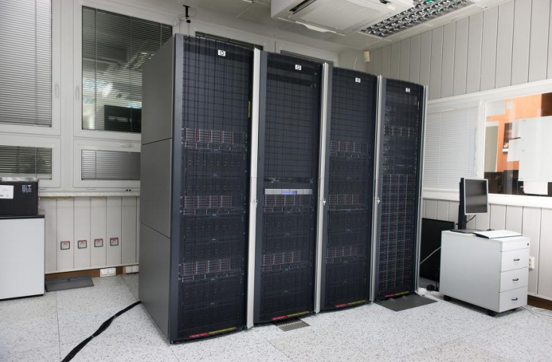
CERIT-SC Centre
an important member/partner of the Czech national grid (∈MetaVO)
provider of HW resources
SMP nodes (>1500 cores, 640 already installed (zewura nodes), another 600 in Q2/2012)
HD nodes (>2500 cores, 600 Q2/2012)
storage capacity (>600 TB)
services beyond the scope of “common” HW centre – an environment for collaborative research
http://www.cerit-sc.cz
Notes:
pasivni HW centrum vs. aktivni HW centrum… (aktivni spolecnik)

Slide 48
CERIT-SC – main activities
Infrastructure
interactive, convenient for experiments (highly flexible)
installed technology serves primarily for research and experiments
the latter purpose is for common computations and data storage/processing
Research and Development
own research, focused on principles/technologies of the maintained eInfrastructure and its optimization
collaborative, comprises a design and optimization of algorithms, models, tools and environment based on the needs of our users/partners
→ a collaboration of IT experts and users
Notes:
na jakych clancich tento aktivni vyzkum stavi?
at se muze soustredit na vlasnti odbornost (informatickou cast prevezme nekdo jiny)

Slide 49
CERIT-SC HW/SW equipment
Hardware:
8 nodes (zewura cluster)
80 cores and 512 MB of memory per node
interconnected by Infiniband
a shared scratch storage (35 TB)
Software:
exactly the same as available on the other MetaVO nodes
Notes:
pasivni HW centrum vs. aktivni HW centrum… (aktivni spolecnik)

Slide 50
Overview
Brief MetaCentrum introduction
Grid infrastructure overview
How to … specify requested resources
How to … run an interactive job
How to … use application modules
How to … run a batch job
How to … determine a job state
How to … run a parallel/distributed computation
Brief CERIT-SC Centre introduction
CERIT-SC specifics

Slide 51
CERIT-SC specifics
In comparison with the MetaVO infrastructure, the CERIT-SC infrastructure has several specifics:
own frontend (zuphux.cerit-sc.cz)
own scheduling server (wagap.cerit-sc.cz)
no queues for jobs’ maximum runtime specification
the maximum runtime is specified via a qsub’s walltime parameter
Notes:
pasivni HW centrum vs. aktivni HW centrum… (aktivni spolecnik)

Slide 52
CERIT-SC: job submission
From CERIT-SC frontend (zuphux.cerit-sc.cz):
“common way” (just walltime specification – see later)
From MetaCentrum frontends:
necessary to specify the CERIT-SC’s scheduling server:
skirit$ qsub –q @wagap.cerit-sc.cz –l ...
Note: It is also possible to submit MetaVO jobs from the CERIT-SC frontend:
zuphux$ qsub –q @arien.ics.muni.cz –l ...
details: http://www.cerit-sc.cz/cs/docs/access/
Notes:
pasivni HW centrum vs. aktivni HW centrum… (aktivni spolecnik)

Slide 53
CERIT-SC: maximum job’s runtime specification
no queues
specified using the qsub’s walltime parameter:
general format: -l walltime=[[hours:]minutes:]seconds[.miliseconds]
examples:
$ qsub -l walltime=30 myjob.sh - a request to submit the myjob.sh script, specifying it's maximum run-time in the length of 30 seconds (submitted via the CERIT-SC frontend)
$ qsub -l walltime=10:00 myjob.sh - a request to submit the myjob.sh script, specifying it's maximum run-time in the length of 10 minutes (submitted via the CERIT-SC frontend)
$ qsub -q @wagap.cerit-sc.cz -l walltime=100:15:00 myjob.sh - a request to submit the myjob.sh script, specifying it's maximum run-time in the length of 100 hours and 15 minutes (submitted via a MetaCentrum frontend)
Notes:
pasivni HW centrum vs. aktivni HW centrum… (aktivni spolecnik)

Slide 54
Thank You for attending!
rebok@ics.muni.cz, makub@ics.muni.cz
www.cesnet.cz www.metacentrum.cz www.cerit-sc.cz
Notes:
spolecna AAI

